Slide 1
Music Generation with RNN and TensorFlow
By
Music Madness!

Slide 2

Title and Content Layout with List

Slide 3
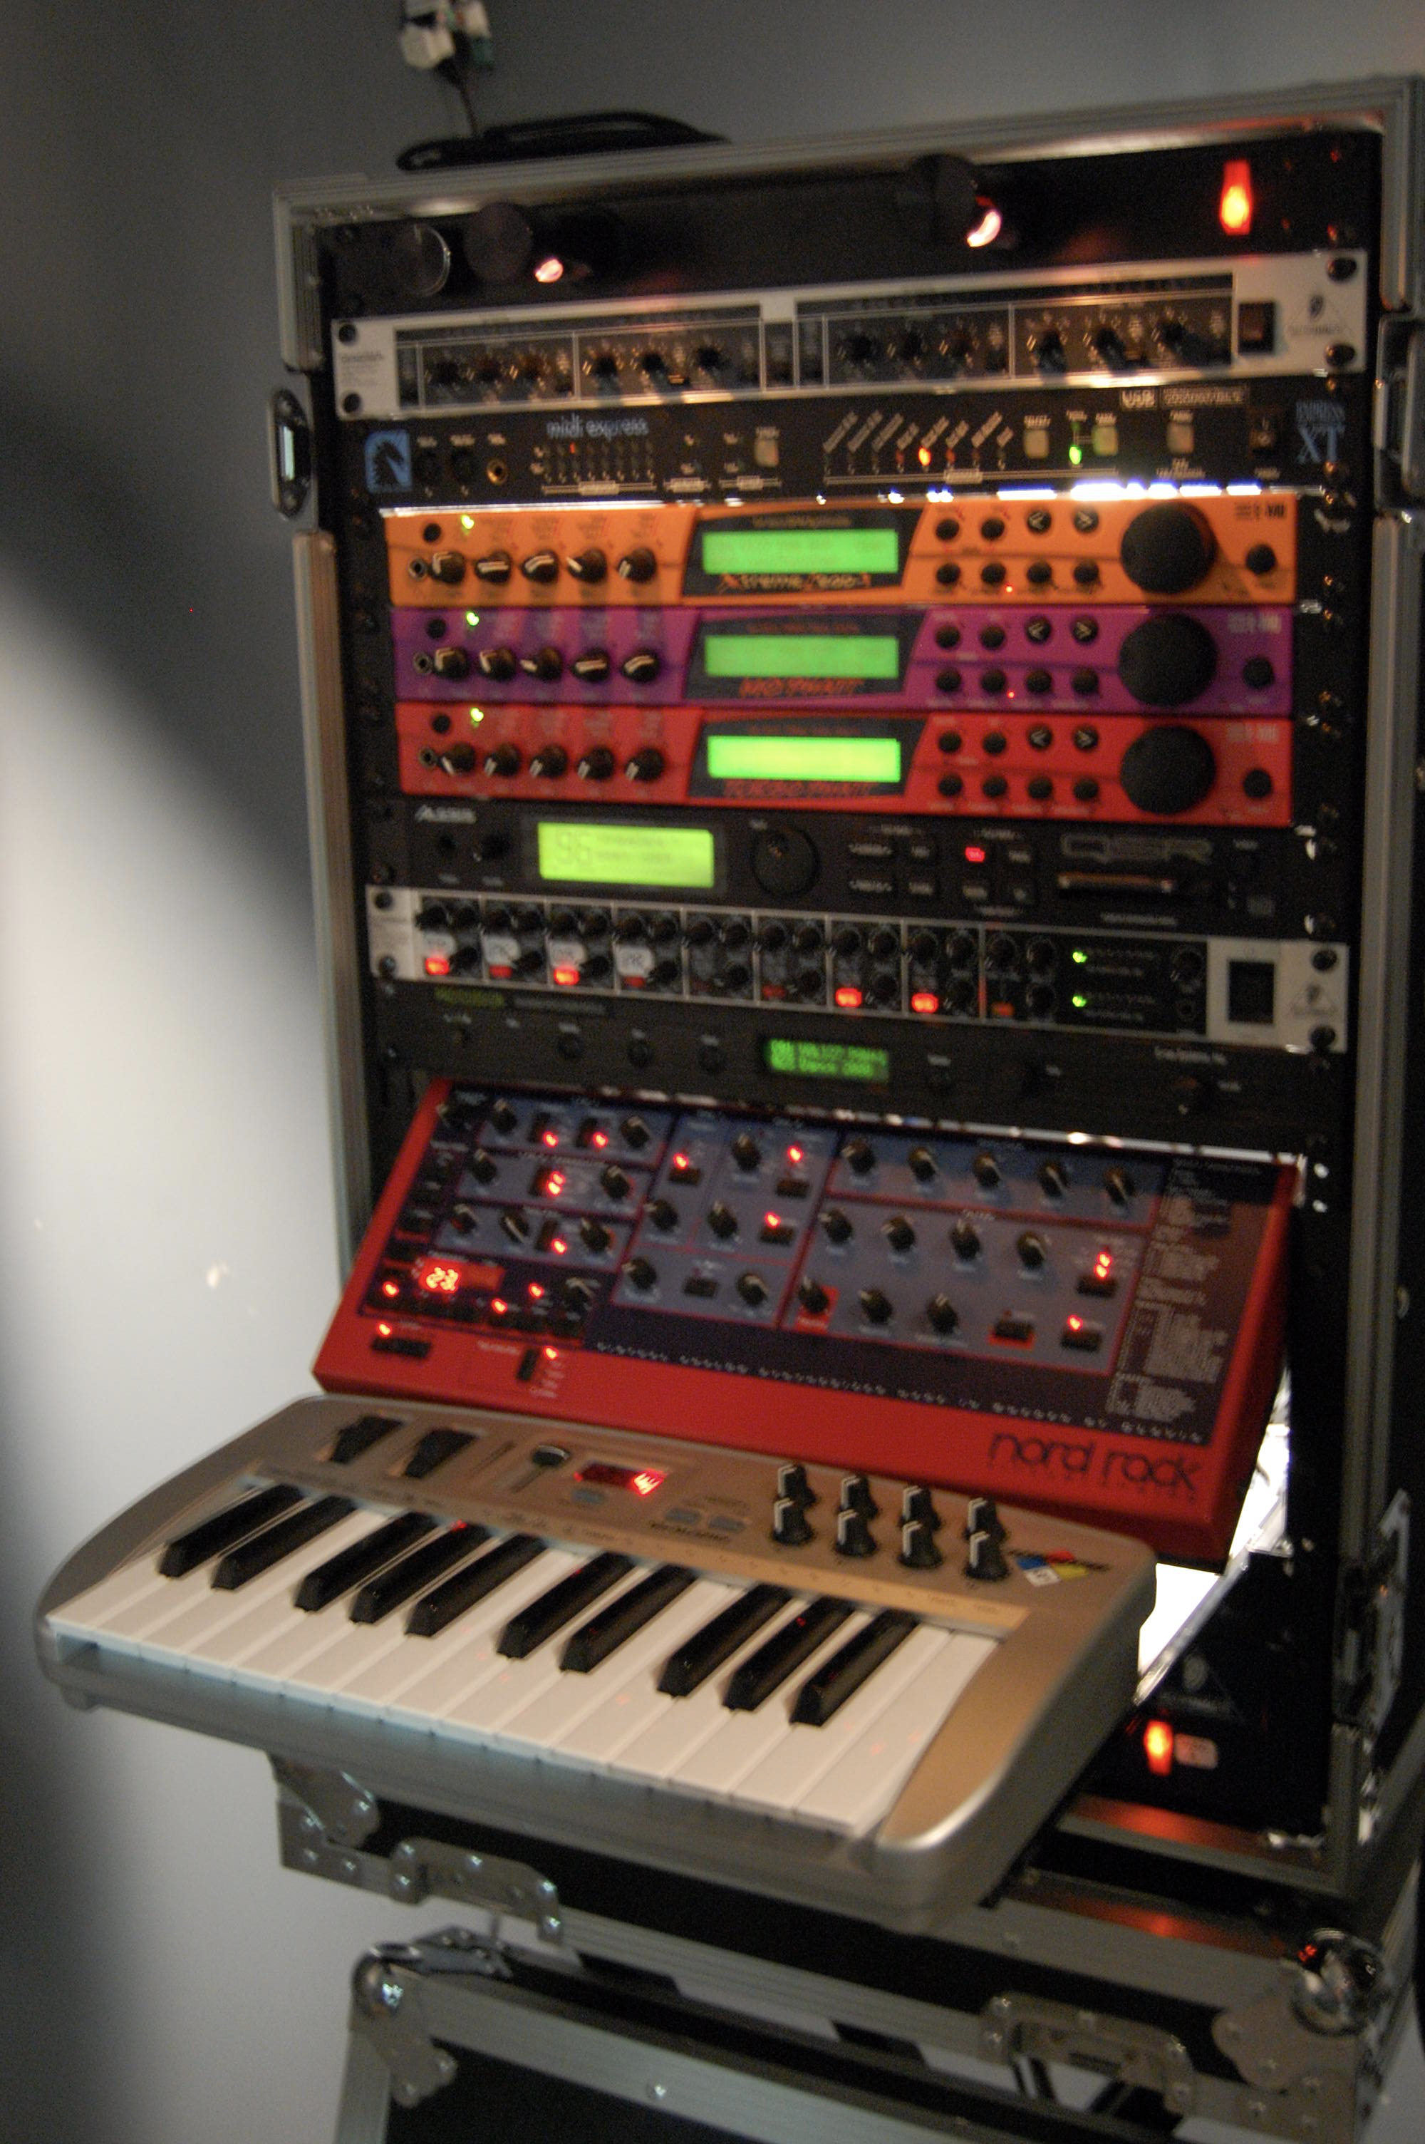
MIDI

Slide 5
Title and Content Layout with Chart

Slide 6
Two Content Layout with Table
Class | Group A | Group B
Class 1 | 82 | 85
Class 2 | 76 | 88
Class 3 | 84 | 90
First bullet point here
Second bullet point here
Third bullet point here

Slide 7
Two Content Layout with SmartArt
First bullet point here
Second bullet point here
Third bullet point here
Group A
Task 1
Task 2
Group B
Task 1
Task 2
Group C
Task 1
Task 2
Group D
Task 1
Task 2

